Slide 1

Bacchus Winery
By: Robert Bean, Hunter Dale,
Vanessa Espino, Seth Glover

Slide 2

Group introduction
Robert Bean- “I'm happy to show our case study on Bucchus Winery, where we'll explore the business strategies and how software solutions can help optimize their operations and drive growth.”
Hunter Dale- “ "I am excited to use the knowledge of SQL and Python scripts to create this presentation.”
Vanessa Espino- “I’m excited to grow my knowledge with this group project.”
Seth Glover- “Software development doesn't happen alone, it's a team effort."

Slide 3
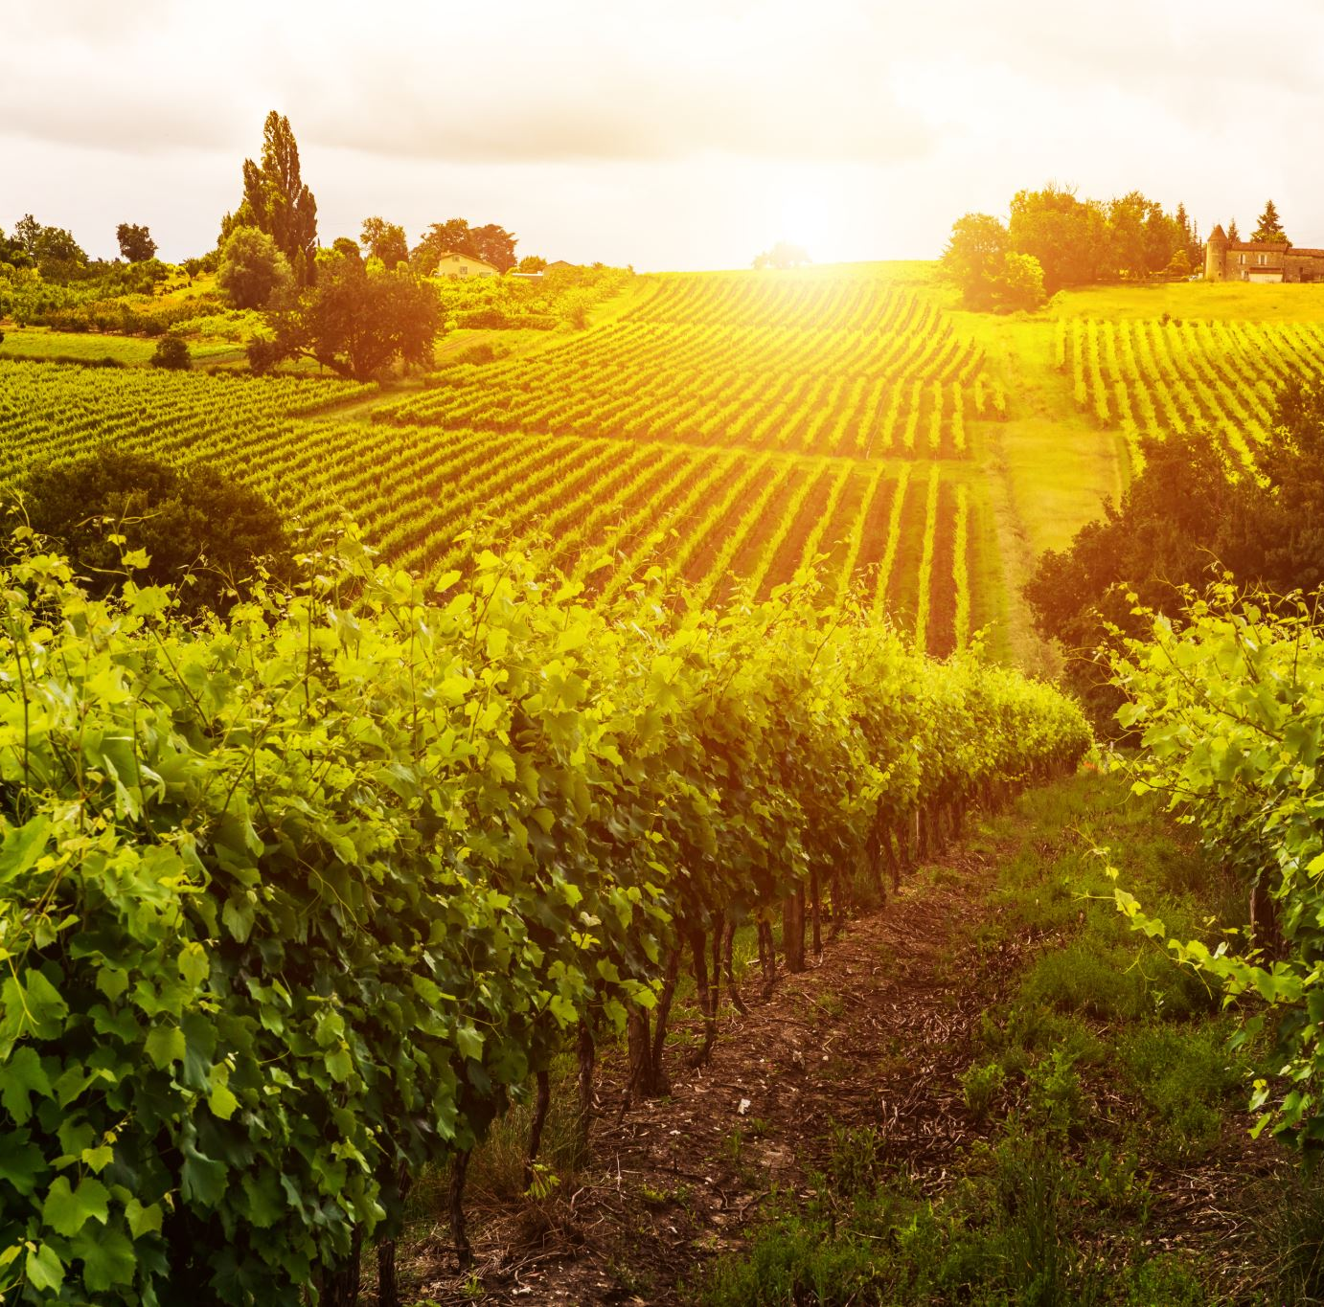
Bacchus winery case study
We chose Bacchus Winery for our case study. Essentially it is asking for a way to find ways to improve their business and customer service. The yearly ‘snapshot’ is coming up and we want to provide reports to answer their questions and concerns. This will help find solutions to improve the business.

Slide 4
ERD

Slide 5
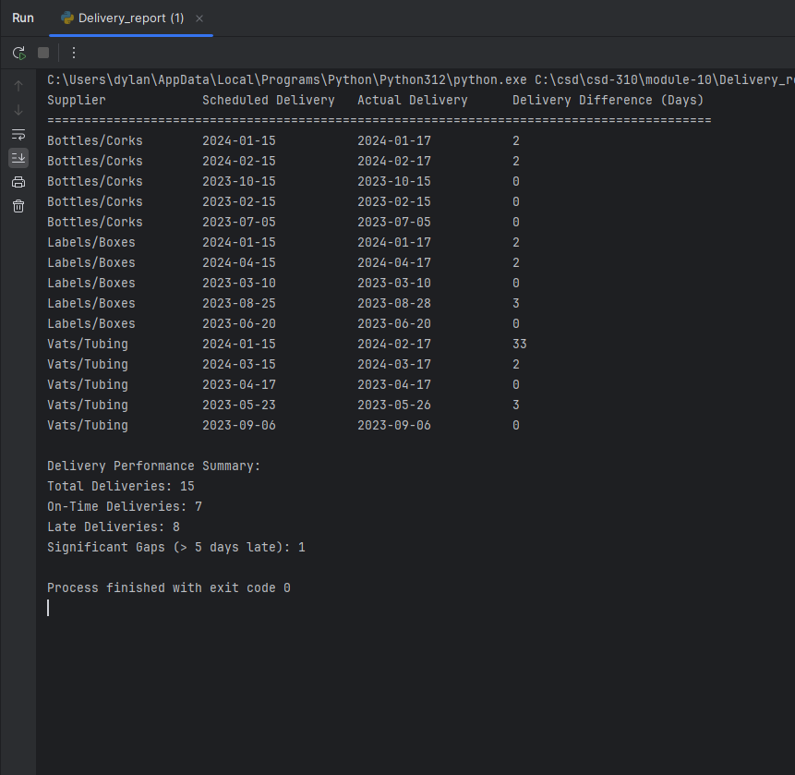
Report one
For our first report, we want to answer the questions made by the new owners of the winery, Stan and Davis, for the yearly ‘snapshot’ of the business. Are all the suppliers delivering on time? Is there a large gap between expected delivery and actual delivery?

Slide 6
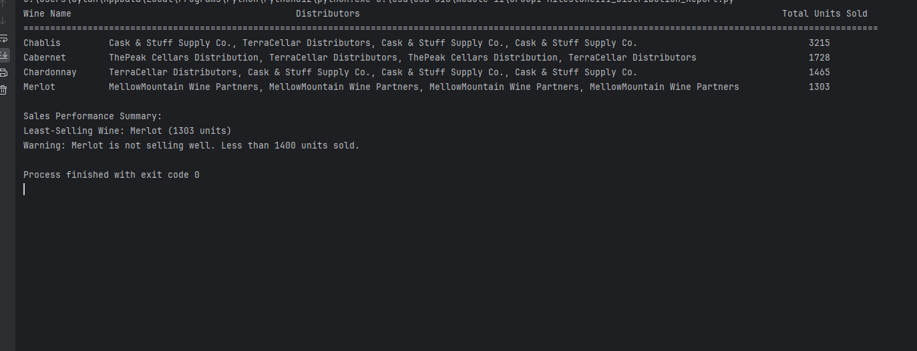
Report two
For our second report, we wanted to find information to get a glimpse of the distribution process. Are all the wines selling? Which distributor carries which wine?

Slide 7
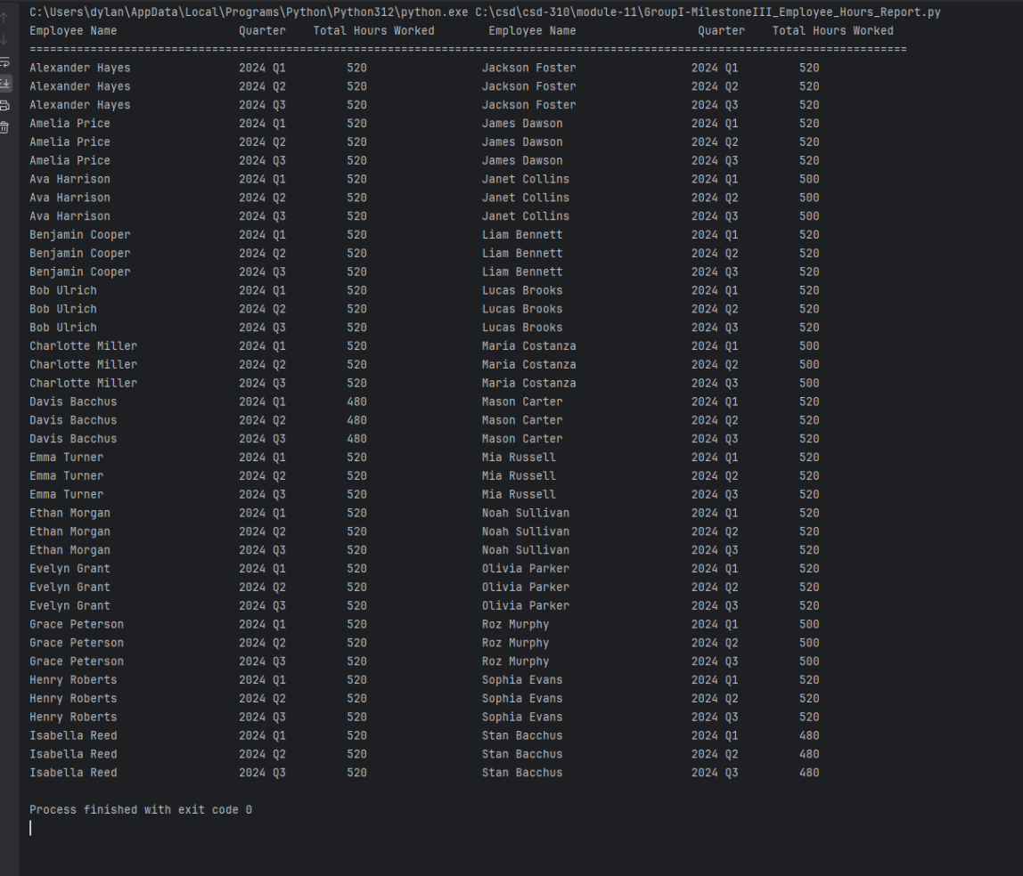
Report three
For our third report we needed to find information about our employees’ time. We needed to look into the last four quarters, how many hours did each employee work?

Slide 8

Assumptions made
In order to make the python scripts, and get the reports we made the following assumptions:
Each department has multiple employees (assuming every employee is a part of a department)
Wine distributor, wine price
Supplier address, phone number and email
Manager phone number, address, and email
Employee phone number, address, and email
Employee hours, employee wage

Slide 9

Conclusion
Our focus for this case study was to get the information Stan and Davis needed when creating the yearly ‘snapshot’ of the business that is due in a few weeks. They needed the information to determine the state of the business, the distribution, and the employees.
The reports that were created would help Stan and Davis find a more efficient method of keeping track and ordering supplies.
The reports that were created would help Maria, who is responsible for distribution, to be able to find a way for suppliers to order online and be able to track shipments.
The reports that were created would help Henry Doyle, who manages the production line, keep track of the employees’ time.
All this information will help Stan and Davis find ways to improve their business and run it more efficiently.

